Slide 1
Chapter 6
Data Types

Slide 2
Introduction
A data type defines a collection of data objects and a set of predefined operations on those objects
A descriptor is the collection of the attributes of a variable
An object represents an instance of a user-defined (abstract data) type
One design issue for all data types: What operations are defined and how are they specified?
Copyright © 2017 Pearson Education, Ltd. All rights reserved.
1-<number>

Slide 3
Primitive Data Types
Almost all programming languages provide a set of primitive data types
Primitive data types: Those not defined in terms of other data types
Copyright © 2017 Pearson Education, Ltd. All rights reserved.
1-<number>

Slide 4
Primitive Data Types: Integer
Java’s signed integer sizes: byte, short, int, long
Copyright © 2017 Pearson Education, Ltd. All rights reserved.
1-<number>

Slide 5
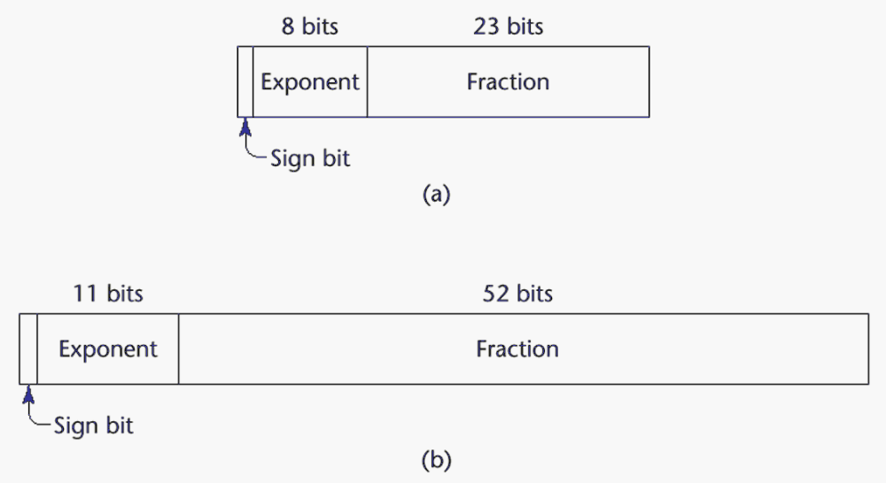
Primitive Data Types: Floating Point
Model real numbers, but only as approximations
Languages for scientific use support at least two floating-point types (e.g., float and double; sometimes more
IEEE Floating-Point
Standard 754
Copyright © 2017 Pearson Education, Ltd. All rights reserved.
1-<number>

Slide 6
Primitive Data Types: Floating Point
Copyright © 2017 Pearson Education, Ltd. All rights reserved.
1-<number>

Slide 7
Primitive Data Types: Complex
Some languages support a complex type, e.g., C99, Fortran, and Python
Each value consists of two floats, the real part and the imaginary part
Literal form (in Python):
(7 + 3j), where 7 is the real part and 3 is the imaginary part
Copyright © 2017 Pearson Education, Ltd. All rights reserved.
1-<number>

Slide 8
Primitive Data Types: Boolean
Simplest of all
Range of values: two elements, one for “true” and one for “false”
Could be implemented as bits, but often as bytes
  Advantage: readability
Copyright © 2017 Pearson Education, Ltd. All rights reserved.
1-<number>

Slide 9
Primitive Data Types: Character
Stored as numeric codings
Most commonly used coding: ASCII
An alternative, 16-bit coding: Unicode (UCS-2)
  Includes characters from most natural languages
  Originally used in Java
  C# and JavaScript also support Unicode
32-bit Unicode (UCS-4)
  Supported by Fortran, starting with 2003
Copyright © 2017 Pearson Education, Ltd. All rights reserved.
1-<number>

Slide 10
Character String Types
Values are sequences of characters
Design issues:
  Is it a primitive type or just a special kind of array?
  Should the length of strings be static or dynamic?
Copyright © 2017 Pearson Education, Ltd. All rights reserved.
1-<number>

Slide 11
Character String Types Operations
Typical operations:
  Assignment and copying
  Comparison (=, >, etc.)
  Catenation
  Substring reference
  Pattern matching
Copyright © 2017 Pearson Education, Ltd. All rights reserved.
1-<number>

Slide 12
Character String Type in Certain Languages
C and C++
  Not primitive
  Use char arrays and a library of functions that provide operations
SNOBOL4 (a string manipulation language)
  Primitive
  Many operations, including elaborate pattern matching
Fortran and Python
  Primitive type with assignment and several operations
Java
  Primitive via the String class
Perl, JavaScript, Ruby, and PHP
- Provide built-in pattern matching, using regular
expressions
Copyright © 2017 Pearson Education, Ltd. All rights reserved.
1-<number>

Slide 13
Character String Length Options
Static: COBOL, Java’s String class
Limited Dynamic Length: C and C++
  In these languages, a special character is used to indicate the end of a string’s characters, rather than maintaining the length
Dynamic (no maximum): SNOBOL4, Perl, JavaScript
Copyright © 2017 Pearson Education, Ltd. All rights reserved.
1-<number>

Slide 14
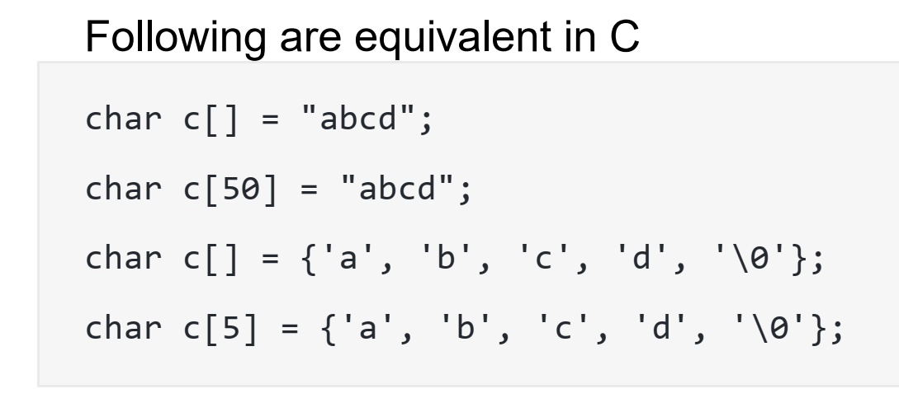
Character String Length Options
Copyright © 2017 Pearson Education, Ltd. All rights reserved.
1-<number>

Slide 15
Character String Implementation
Static length: compile-time descriptor
Limited dynamic length: may need a run-time descriptor for length (but not in C and C++)
Dynamic length: need run-time descriptor; allocation/deallocation is the biggest implementation problem
Copyright © 2017 Pearson Education, Ltd. All rights reserved.
1-<number>

Slide 16
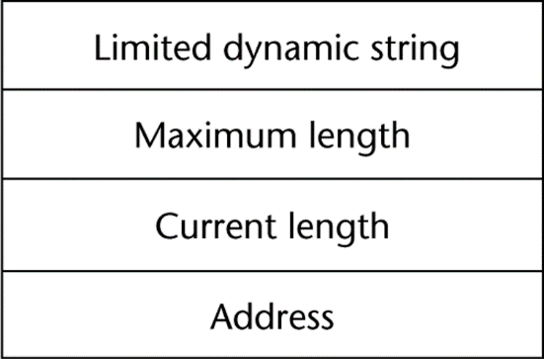
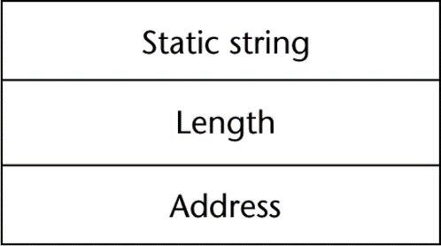
Compile- and Run-Time Descriptors
Compile-time descriptor for static strings
Run-time descriptor for limited dynamic strings
Copyright © 2017 Pearson Education, Ltd. All rights reserved.
1-<number>

Slide 17
Enumeration Types
All possible values, which are named constants, are provided in the definition
C# example
  enum days {mon, tue, wed, thu, fri, sat, sun};
Design issues
  Are enumeration values coerced to integer?
  Any other type coerced to an enumeration type?
Copyright © 2017 Pearson Education, Ltd. All rights reserved.
1-<number>

Slide 18
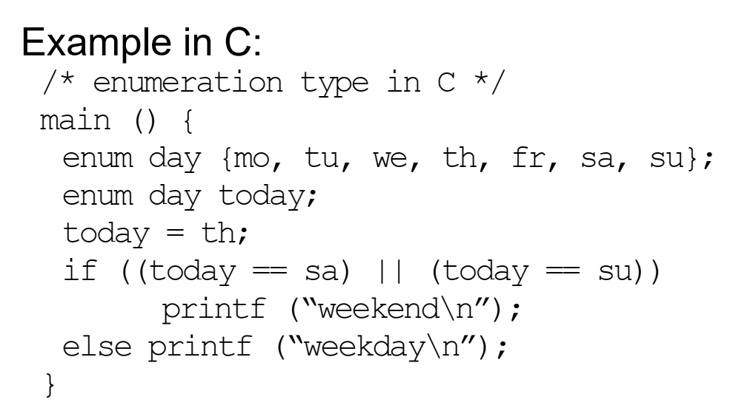
Enumeration Types
Copyright © 2017 Pearson Education, Ltd. All rights reserved.
1-<number>

Slide 19
Evaluation of Enumerated Type
Aid to reliability, e.g., compiler can check:
  No enumeration variable can be assigned a value outside its defined range
  C# and Java 5.0 provide better support for enumeration than C++ because enumeration type variables in these languages are not coerced into integer types
Copyright © 2017 Pearson Education, Ltd. All rights reserved.
1-<number>

Slide 20
Array Types
An array is a homogeneous aggregate of data elements in which an individual element is identified by its position in the aggregate, relative to the first element.
Copyright © 2017 Pearson Education, Ltd. All rights reserved.
1-<number>

Slide 21
Array Design Issues
What types are legal for subscripts?
Are subscripting expressions in element references range checked?
When are subscript ranges bound?
When does allocation take place?
Are ragged (irregular) or rectangular multidimensional arrays allowed, or both?
What is the maximum number of subscripts?
Can array objects be initialized?
Are any kind of slices supported?
Copyright © 2017 Pearson Education, Ltd. All rights reserved.
1-<number>

Slide 22
Array Indexing
Indexing (or subscripting) is a mapping from indices to elements
array_name (index_value_list) → an element
Index Syntax
  Fortran and Ada use parentheses
    Ada explicitly uses parentheses to show uniformity between array references and function calls because both are mappings
  Most other languages use brackets
    [ ]
Copyright © 2017 Pearson Education, Ltd. All rights reserved.
1-<number>

Slide 23
Arrays Index (Subscript) Types
FORTRAN, C: integer only
Java: integer types only
Index range checking
- C, C++, Perl, and Fortran do not specify
range checking
- Java, ML, C# specify range checking
Copyright © 2017 Pearson Education, Ltd. All rights reserved.
1-<number>

Slide 24
Subscript Binding and Array Categories
The lower bound of the subscript range is implicit.
  C: Fixed at 0
  Others: must be specified bu the programmer
Static Array: subscript ranges are statically bound and storage allocation is static (before run-time)
  Advantage: efficiency (no dynamic allocation)
  Disadv: storage for the array is fixed for the entire execution time of the program
Copyright © 2017 Pearson Education, Ltd. All rights reserved.
1-<number>

Slide 25
Subscript Binding and Array Categories (continued)
Fixed stack-dynamic array:
  subscript ranges are statically bound, but the allocation is done at declaration time during execution.
  Advantage: space efficiency
  Disadv: Required allc/dealloc time
Fixed heap-dynamic array:
  Subscript ranges and the storage binding are both fixed after storage is allocated.
    Subscript ranges & storage bindings are done when the user program requests them during execution
    storage is allocated from heap, not stack
Copyright © 2017 Pearson Education, Ltd. All rights reserved.
1-<number>

Slide 26
Subscript Binding and Array Categories (continued)
Heap-dynamic array:
  binding of subscript ranges and storage allocation is dynamic and can change any number of times
  Advantage: flexibility (arrays can grow or shrink during program execution)
Copyright © 2017 Pearson Education, Ltd. All rights reserved.
1-<number>

Slide 27
Subscript Binding and Array Categories (continued)
C and C++ arrays that include static modifier are static
C and C++ arrays without static modifier are fixed stack-dynamic
C and C++ provide fixed heap-dynamic arrays (malloc/free C functions, new /delete)
C# includes a second array class ArrayList that provides fixed heap-dynamic
Perl, JavaScript, Python, and Ruby support heap-dynamic arrays
Copyright © 2017 Pearson Education, Ltd. All rights reserved.
1-<number>

Slide 28
Array Initialization
Some languages allow initialization at the time of storage allocation
  C, C++, Java, C# example
  int list [] = {4, 5, 7, 83}
  Character strings in C and C++
  char name [] = ″freddie″;
  Arrays of strings in C and C++
  char *names [] = {″Bob″, ″Jake″, ″Joe″];
  Java initialization of String objects
  String[] names = {″Bob″, ″Jake″, ″Joe″};
Copyright © 2017 Pearson Education, Ltd. All rights reserved.
1-<number>

Slide 29
Heterogeneous Arrays
A heterogeneous array is one in which the elements need not be of the same type
Supported by Perl, Python, JavaScript, and Ruby
Copyright © 2017 Pearson Education, Ltd. All rights reserved.
1-<number>

Slide 30
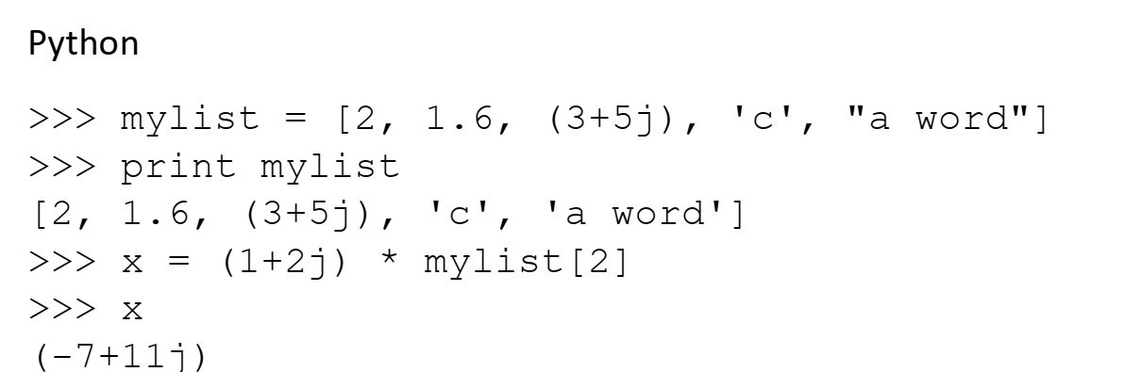
Heterogeneous Arrays
Copyright © 2017 Pearson Education, Ltd. All rights reserved.
1-<number>

Slide 31
Array Initialization
C-based languages
  int list [] = {1, 3, 5, 7}
  char *names [] = {″Mike″, ″Fred″, ″Mary Lou″};
Python
  List comprehensions
  list = [x ** 2 for x in range(12) if x % 3 == 0]
  puts [0, 9, 36, 81] in list
Copyright © 2017 Pearson Education, Ltd. All rights reserved.
1-<number>

Slide 32
Rectangular and Jagged Arrays
A rectangular array is a multi-dimensioned array in which all of the rows have the same number of elements and all columns have the same number of elements
A jagged matrix has rows with varying number of elements
  Possible when multi-dimensioned arrays actually appear as arrays of arrays
C, C++, and Java support jagged arrays
F# and C# support rectangular arrays and jagged arrays
Copyright © 2017 Pearson Education, Ltd. All rights reserved.
1-<number>

Slide 33
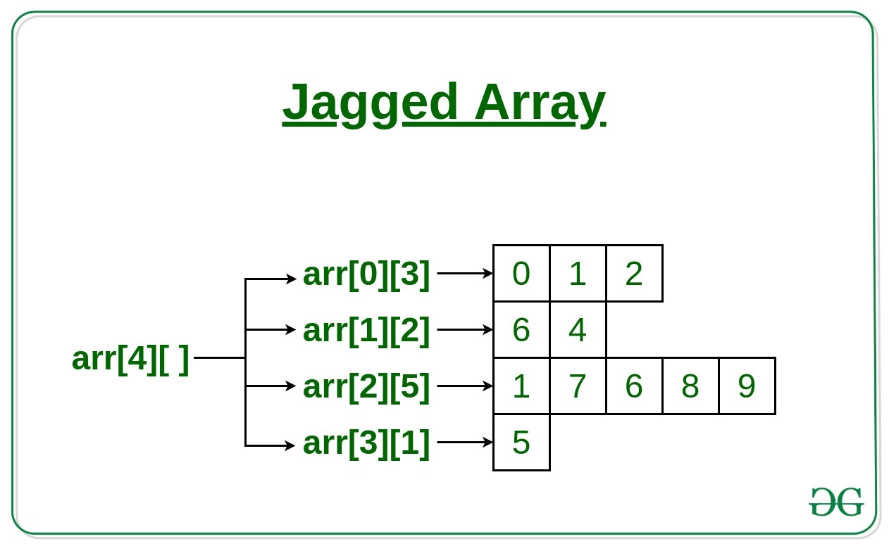
Jagged Arrays
Copyright © 2017 Pearson Education, Ltd. All rights reserved.
1-<number>

Slide 34
Slices
A slice is some substructure of an array; nothing more than a referencing mechanism
Slices are only useful in languages that have array operations
Copyright © 2017 Pearson Education, Ltd. All rights reserved.
1-<number>

Slide 35
Slice Examples
Python
  vector = [2, 4, 6, 8, 10, 12, 14, 16]
  mat = [[1, 2, 3], [4, 5, 6], [7, 8, 9]]
  vector [3:6] is a three-element array
  mat[0][0:2] is the first and second element of the first row of mat
Ruby supports slices with the slice method
  list.slice(2, 2) returns the third and fourth elements of list
Copyright © 2017 Pearson Education, Ltd. All rights reserved.
1-<number>

Slide 36
Associative Arrays
An associative array is an unordered collection of data elements that are indexed by an equal number of values called keys
  User-defined keys must be stored
Design issues:
- What is the form of references to elements?
- Is the size static or dynamic?
Built-in type in Perl, Python, Ruby, and Lua
  In Lua, they are supported by tables
Copyright © 2017 Pearson Education, Ltd. All rights reserved.
1-<number>

Slide 37
Associative Arrays in Perl
Names begin with %; literals are delimited by parentheses
  %hi_temps = ("Mon" => 77, "Tue" => 79, "Wed" => 65, …);
Subscripting is done using braces and keys
  $hi_temps{"Wed"} = 83;
  Elements can be removed with delete
  delete $hi_temps{"Tue"};
Copyright © 2017 Pearson Education, Ltd. All rights reserved.
1-<number>

Slide 38
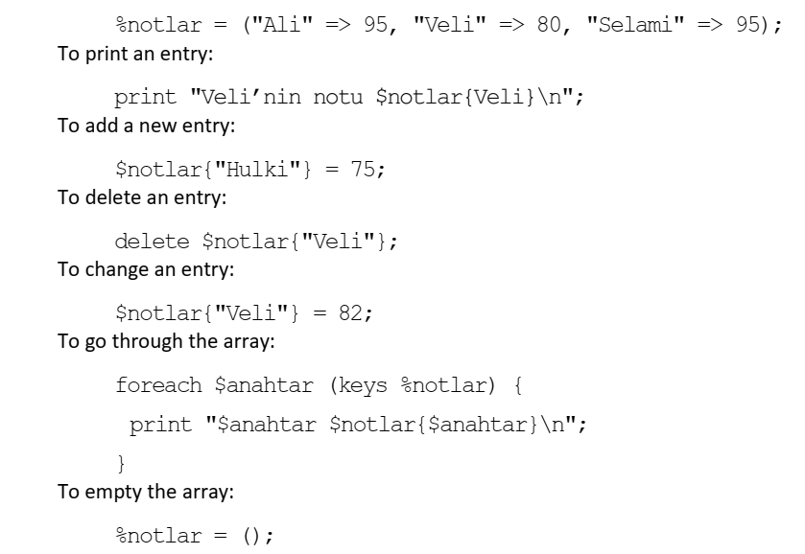
Associative Arrays in Perl
Copyright © 2017 Pearson Education, Ltd. All rights reserved.
1-<number>

Slide 39
Tuple Types
A tuple is a data type that is similar to a record, except that the elements are not named
Used in Python, ML, and F# to allow functions to return multiple values
  Python
    Closely related to its lists, but immutable
    Create with a tuple literal
    myTuple = (3, 5.8, ′apple′)
Copyright © 2017 Pearson Education, Ltd. All rights reserved.
1-<number>

Slide 40
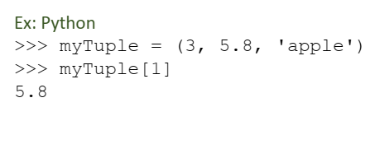
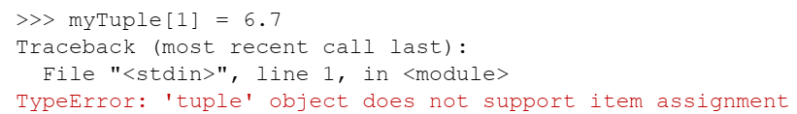
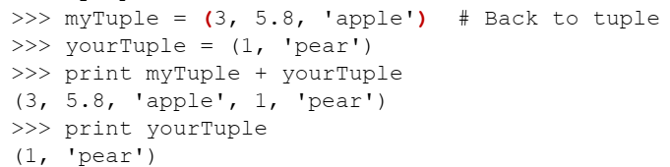
Tuple Types
Copyright © 2017 Pearson Education, Ltd. All rights reserved.
1-<number>

Slide 41
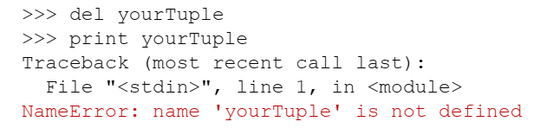
Tuple Types
Copyright © 2017 Pearson Education, Ltd. All rights reserved.
1-<number>

Slide 42
List Types
Lists in Lisp and Scheme are delimited by parentheses and use no commas
(A B C D) and (A (B C) D)
Data and code have the same form
As data, (A B C) is literally what it is
As code, (A B C) is the function A applied to the
parameters B and C
The interpreter needs to know which a list is, so if it is data, we quote it with an apostrophe
′(A B C) is data
Copyright © 2017 Pearson Education, Ltd. All rights reserved.
1-<number>

Slide 43
List Types (continued)
List Operations in Scheme
  CAR returns the first element of its list parameter
  (CAR ′(A B C)) returns A
  CDR returns the remainder of its list parameter after the first element has been removed
  (CDR ′(A B C)) returns (B C)
  - CONS puts its first parameter into its second parameter, a list, to make a new list
  (CONS ′A (B C)) returns (A B C)
  LIST returns a new list of its parameters
  (LIST ′A ′B ′(C D)) returns (A B (C D))
Copyright © 2017 Pearson Education, Ltd. All rights reserved.
1-<number>

Slide 44
List Types (continued)
Python Lists
  The list data type also serves as Python’s arrays
  Unlike Scheme, Common Lisp, ML, and F#, Python’s lists are mutable
  Elements can be of any type
  Create a list with an assignment
  myList = [3, 5.8, "grape"]
Copyright © 2017 Pearson Education, Ltd. All rights reserved.
1-<number>

Slide 45
List Types (continued)
Python Lists (continued)
  List elements are referenced with subscripting, with indices beginning at zero
  x = myList[1] Sets x to 5.8
  List elements can be deleted with del
  del myList[1]
  List Comprehensions – derived from set notation
  [x * x for x in range(7) if x % 3 == 0]
  range(7) creates [0, 1, 2, 3, 4, 5, 6]
  Constructed list: [0, 9, 36]
Copyright © 2017 Pearson Education, Ltd. All rights reserved.
1-<number>

Slide 46
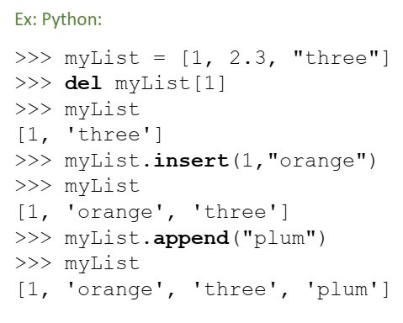
List Types (continued)
Copyright © 2017 Pearson Education, Ltd. All rights reserved.
1-<number>

Slide 47
List Types (continued)
Haskell’s List Comprehensions
  The original
  [n * n | n <- [1..10]]
F#’s List Comprehensions
let myArray = [|for i in 1 .. 5 -> [i * i) |]
Both C# and Java supports lists through their generic heap-dynamic collection classes, List and ArrayList, respectively
Copyright © 2017 Pearson Education, Ltd. All rights reserved.
1-<number>

Slide 48
Unions Types
A union is a type whose variables are allowed to store different type values at different times during execution
Design issue
  Should type checking be required?
Copyright © 2017 Pearson Education, Ltd. All rights reserved.
1-<number>

Slide 49
Discriminated vs. Free Unions
C and C++ provide union constructs in which there is no language support for type checking; the union in these languages is called free union
Copyright © 2017 Pearson Education, Ltd. All rights reserved.
1-<number>

Slide 50
Evaluation of Unions
Free unions are unsafe
  Do not allow type checking
Java and C# do not support unions
Copyright © 2017 Pearson Education, Ltd. All rights reserved.
1-<number>

Slide 51
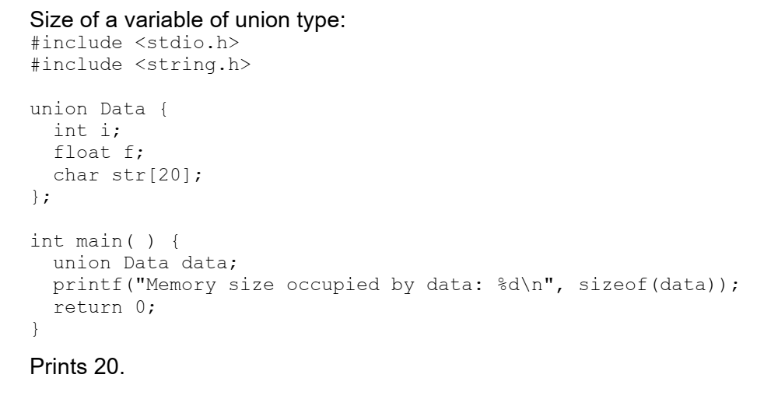
Evaluation of Unions
Copyright © 2017 Pearson Education, Ltd. All rights reserved.
1-<number>

Slide 52
Pointer and Reference Types
A pointer type variable has a range of values that consists of memory addresses and a special value, nil
Provide the power of indirect addressing
Provide a way to manage dynamic memory
A pointer can be used to access a location in the area where storage is dynamically created (usually called a heap )
Copyright © 2017 Pearson Education, Ltd. All rights reserved.
1-<number>

Slide 53
Design Issues of Pointers
What are the scope of and lifetime of a pointer variable?
What is the lifetime of a heap-dynamic variable?
Are pointers restricted as to the type of value to which they can point?
Are pointers used for dynamic storage management, indirect addressing, or both?
Should the language support pointer types, reference types, or both?
Copyright © 2017 Pearson Education, Ltd. All rights reserved.
1-<number>

Slide 54
Pointer Operations
Two fundamental operations: assignment and dereferencing
Assignment is used to set a pointer variable’s value to some useful address
Dereferencing yields the value stored at the location represented by the pointer’s value
  Dereferencing can be explicit or implicit
  C++ uses an explicit operation via *
  j = *ptr
  sets j to the value located at ptr
Copyright © 2017 Pearson Education, Ltd. All rights reserved.
1-<number>

Slide 55
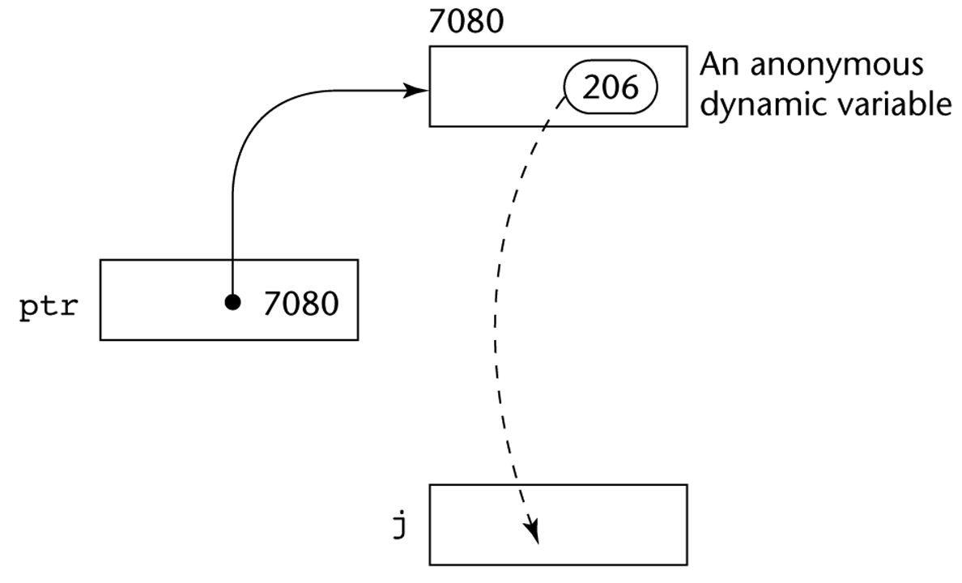
Pointer Assignment Illustrated
The assignment operation j = *ptr
Copyright © 2017 Pearson Education, Ltd. All rights reserved.
1-<number>

Slide 56
Problems with Pointers
Dangling pointers (dangerous)
  A pointer points to a heap-dynamic variable that has been deallocated
Lost heap-dynamic variable
  An allocated heap-dynamic variable that is no longer accessible to the user program (often called garbage)
    Pointer p1 is set to point to a newly created heap-dynamic variable
    Pointer p1 is later set to point to another newly created heap-dynamic variable
    The process of losing heap-dynamic variables is called memory leakage
Copyright © 2017 Pearson Education, Ltd. All rights reserved.
1-<number>

Slide 57
Problems with Pointers
int *arrayPtr1;
int *arrayPtr2;
arrayPtr1=arrayPtr2;
delete [] arrayPtr2;
NOW arrayPtr1 is dangling → heap storage to which it was pointing has been DEALLOCATED!
Copyright © 2017 Pearson Education, Ltd. All rights reserved.
1-<number>

Slide 58
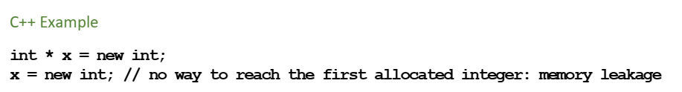
Problems with Pointers
Copyright © 2017 Pearson Education, Ltd. All rights reserved.
1-<number>

Slide 59
Pointers in C and C++
Extremely flexible but must be used with care
Pointers can point at any variable regardless of when or where it was allocated
Used for dynamic storage management and addressing
Pointer arithmetic is possible
Copyright © 2017 Pearson Education, Ltd. All rights reserved.
1-<number>

Slide 60
Pointer Arithmetic in C and C++
float stuff[100];
float *p;
p = stuff;
*(p+5) is equivalent to stuff[5] and p[5]
*(p+i) is equivalent to stuff[i] and p[i]
Copyright © 2017 Pearson Education, Ltd. All rights reserved.
1-<number>

Slide 61
Type Checking
Type checking is the activity of ensuring that the operands of an operator are of compatible types
A compatible type is one that is either legal for the operator, or is allowed under language rules to be implicitly converted, by compiler- generated code, to a legal type
  This automatic conversion is called a coercion.
A type error is the application of an operator to an operand of an inappropriate type
Copyright © 2017 Pearson Education, Ltd. All rights reserved.
1-<number>

Slide 62
Type Checking (continued)
If all type bindings are static, nearly all type checking can be static
If type bindings are dynamic, type checking must be dynamic
A programming language is strongly typed if type errors are always detected
Advantage of strong typing: allows the detection of the misuses of variables that result in type errors
Copyright © 2017 Pearson Education, Ltd. All rights reserved.
1-<number>

Slide 63
Strong Typing
Language examples:
  C and C++ are not strongly typed: parameter type checking can be avoided; unions are not type checked
  Java and C# are, almost (because of explicit type casting)
  - ML and F# are
Copyright © 2017 Pearson Education, Ltd. All rights reserved.
1-<number>

Slide 64
Strong Typing (continued)
Coercion rules strongly affect strong typing--they can weaken it considerably (C++ versus ML and F#)
Although Java has just half the assignment coercions of C++, its strong typing is still far less effective than that of Ada
Copyright © 2017 Pearson Education, Ltd. All rights reserved.
1-<number>

Slide 65
Name Type Equivalence
Name type equivalence means the two variables have equivalent types if they are in either the same declaration or in declarations that use the same type name
Compatibility w/o COERCION
Copyright © 2017 Pearson Education, Ltd. All rights reserved.
1-<number>

Slide 66
Structure Type Equivalence
Structure type equivalence means that two variables have equivalent types if their types have identical structures
Copyright © 2017 Pearson Education, Ltd. All rights reserved.
1-<number>

Slide 67
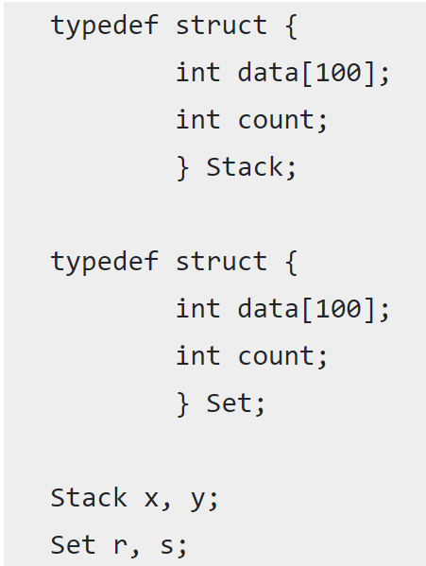
EXAMPLE
if name equivalence is used in the language then x and y would be of the same type and r and s would be of the same type, but the type of x or y would not be equivalent to the type of r or s.
Copyright © 2017 Pearson Education, Ltd. All rights reserved.
1-<number>

Slide 68
EXAMPLE name equivalence
//VALID
x = y;
r = s;
//INVALID
x=r;
Copyright © 2017 Pearson Education, Ltd. All rights reserved.
1-<number>

Slide 69
EXAMPLE Structural equivalence
//VALID
x=r;
C doesn't support structural equivalence and will give error for above assignment (x=r;)
Copyright © 2017 Pearson Education, Ltd. All rights reserved.
1-<number>

Slide 70
Summary
The data types of a language are a large part of what determines that language’s style and usefulness
The primitive data types of most imperative languages include numeric, character, and Boolean types
The user-defined enumeration and subrange types are convenient and add to the readability and reliability of programs
Arrays and records are included in most languages
Pointers are used for addressing flexibility and to control dynamic storage management
Copyright © 2017 Pearson Education, Ltd. All rights reserved.
1-<number>

